Slide 1
Region 3 PIAC Meeting
THE MANY WORKING AS ONE FOR THE GOOD OF ALL
March 6, 2019

Slide 2
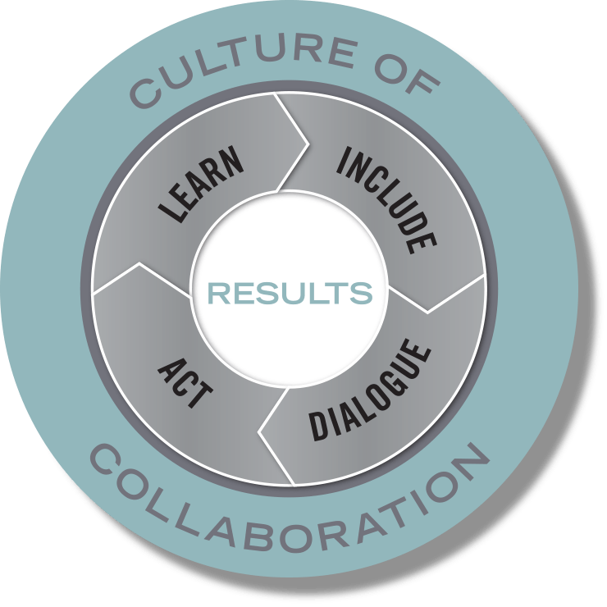



Purpose and Vision: The many working as one for the good of all
Mission: to create a culture of collaboration that drives transformative change
Build Connections
Build Capacity
Build a Movement
Notes:
The Civic Canopy transforms the way pivotal issues are solved by creating a culture of collaboration across Colorado
The Civic Canopy is a community-based nonprofit working to connect diverse groups of people seeking change in their communities
We use a research-based Community Learning Model to drive our work supporting a 3 part platform that:
Builds connections through shared technology;
Builds capacity through training and technical assistance; and
Builds a movement through engagement and advocacy

Slide 3
Meeting Objectives
Strengthen the connections and trust among PIAC members.
Understand how a collective impact approach can improve population level health outcomes for Region 3 and 5
Develop a clearer understanding of the role PIAC in the collective impact approach
Clarify the next steps for the PIAC

Slide 4

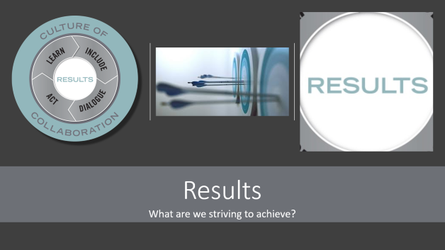
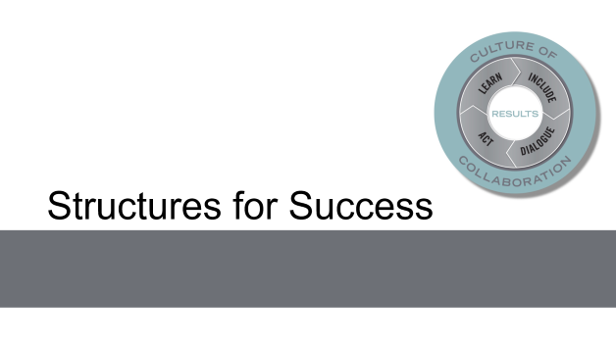
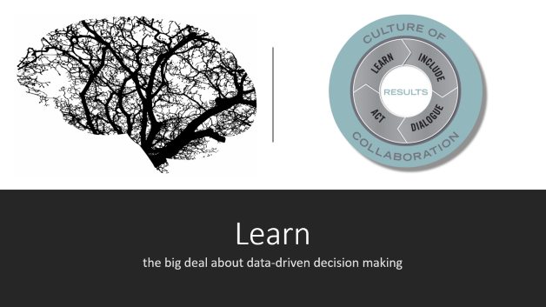
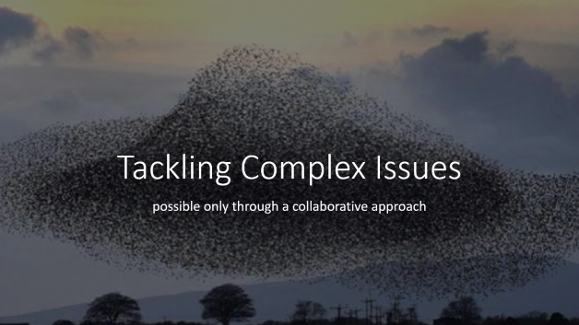
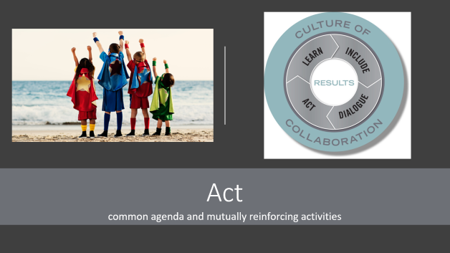

Slide 5
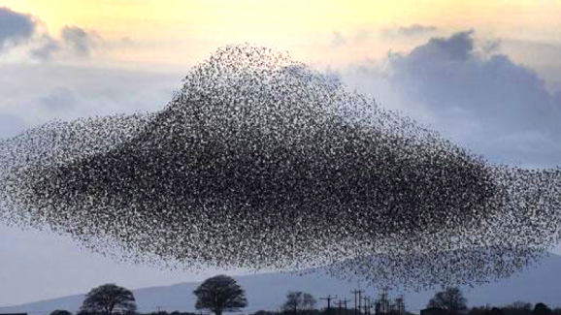
Tackling Complex Issues
possible only through a collaborative approach

Slide 6
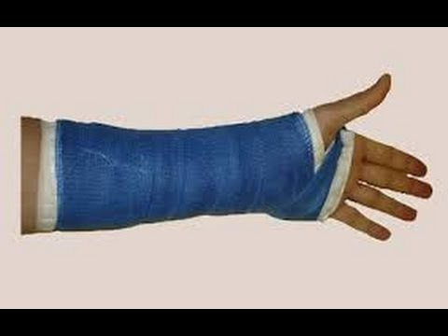


Problem Types and Solution Orientations
Definition of Problem | Definition of Solution | Kind of Challenge | Type of Solution | Examples
Clear | Clear | Simple | Technical Problem Solving
Clear | Unclear | Complicated | Adaptive Strategy
Unclear | Unclear | Complex | Emergent Solutions
Adapted from Ron Heifetz, Leadership Without Easy Answers, 1994, and Fourth Quadrant Partners, A Whole Greater Than Its Parts, 2018.

Slide 7

Notes:
Article came out in 2011—spread like wildfire. Really hit a nerve. 50 people must have forwarded it to us saying “I think this is what you’ve been talking about.” And everyone felt that way—that they had been doing this all along but hadn’t labled it collective impact.

Slide 8
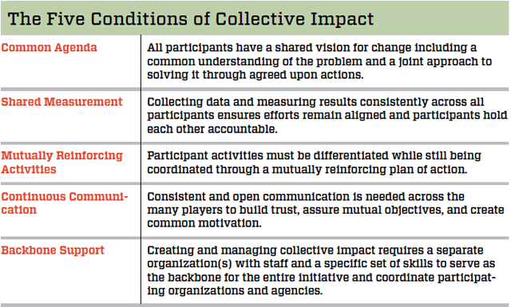
Kania and Kramer, 2011
Notes:
Provided an operating manual for how we’re supposed to organize ourselves, gave language to our efforts

Slide 9

Collaborative Action/Collective Impact
A group working towards the same outcome
Using shared population and performance measures
To continuously improve practices over time
Coordinated Action
A group working on the same issue,
Sharing program information/design,
Align efforts around a similar issue or population
Individual Action
Individual practioners working on specific issues,
Collecting qualitative and quantitative data for their individual programs,
Demonstrate impact with individual programs
Adapted from the Strive Together Partnership
Notes:
Useful way to visualize the difference between collective impact and our typical and current practice of isolated impact is to think of each arrow as an organization’s or group contribution. Frequently they all feel like they are working against each other, heading in separate directions. With intention and commitment, groups can move to align their efforts toward shared goals. If they take the next big leap, often involving a more explicit shared agenda and more rigorous strategic learning and accountability, they reach even deeper, collective impact.

Slide 10
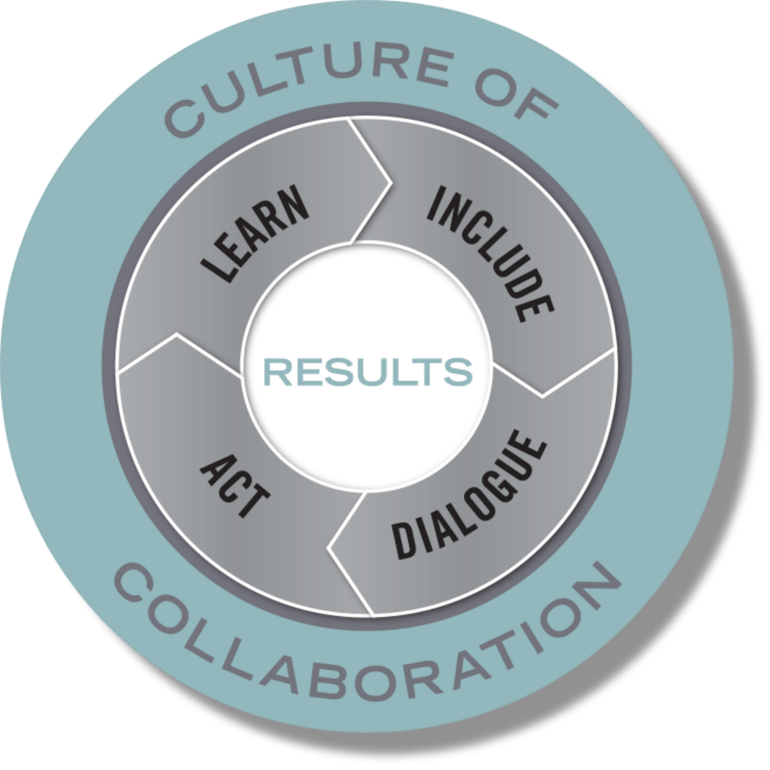
Community Learning Model
Synthesis of research on effective teams and collaboratives
Correlation between the quality of process and quality of population outcomes
Provides a way to think about the ongoing work of creating collective impact through continuous improvement
Notes:
Canopy’s Community Learning Model

Slide 11
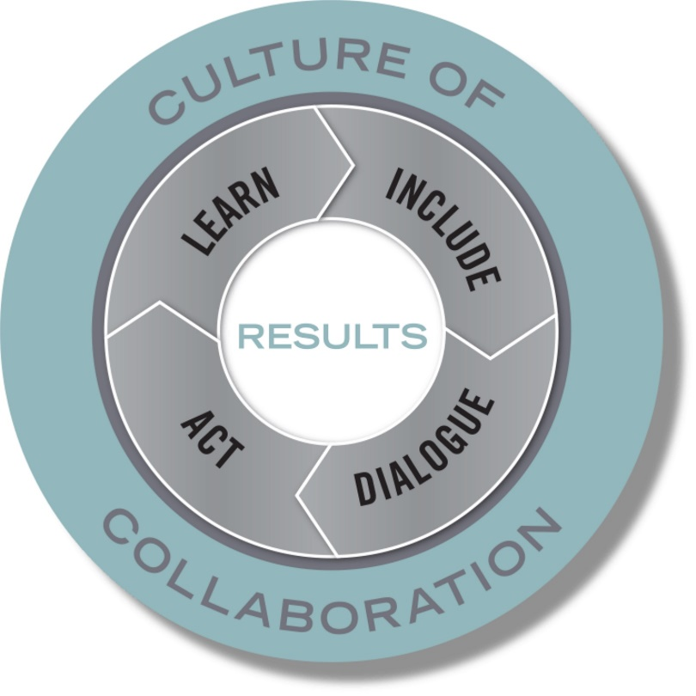

Results
What are we striving to achieve?
Notes:
At the core of all successful collaborative work is a set of identified, shared results. WHAT we are striving to achieve.

Slide 12
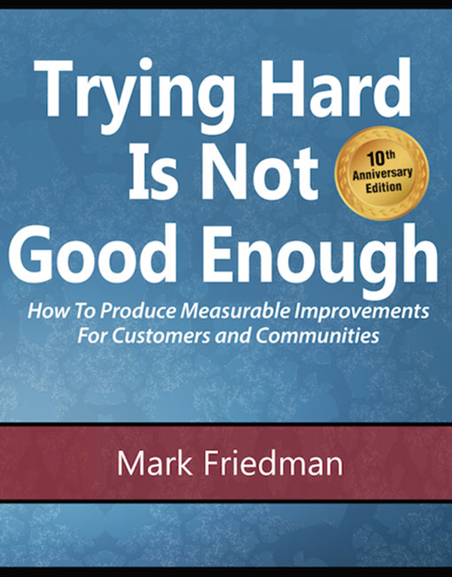


Based on the work of:
www.clearimpact.com
Notes:
Mike Schmoker’s work around Results in the educational setting was tremendously influential in the early years of the Canopy; Friedman’s work around RBA laid the foundation for the methods and framework; and Clear Impact helped train us in the methods and tools we use today.

Slide 13
Language Discussion
Always go back to the original idea:
Ideas | Group 1 | Group 2 | Group 3
1. A condition of well-being for children, adults, families and the community. | RESULT | OUTCOME | GOAL
Notes:
When there’s confusion about a particular term, always go back to what the original idea is (i.e. is this a condition of wellbeing or is it a measure, strategy? Etc.)
Brainstorm: when we say the term RESULT, what are other terms people often use to distinguish? How can they be easily misinterpreted?

Slide 14
Key Definitions
Colorado has a prosperous economy.
Arvada is a safe and supportive community.
All Jeffco residents with developmental disabilities are supported
RESULT
A condition of well-being for children, adults, families or communities.
Population Accountability
Employment rates
Violent crime rates
Mental health supports available
INDICATOR
A measure which helps quantify the achievement of a result.
1. How much did we do?
2. How well did we do it?
3. Is anyone better off?
PERFORMANCE MEASURE
Performance Accountability
A measure of how well a program, agency or service system is working.
Notes:
Let’s start with some key definitions…
So breaking down these levels of accountability…
At the HIGHEST LEVEL on the population accountability level, we have RESULTS…..
On the population level, which you will remember is concerned with whole populations, we call a result a condition of well-being…
Indicators are measures which help quantify the achievement of a result. So, for example, the rate of low-birthweight babies helps quantify whether we're getting healthy births or not…
Performance Measures are measures of how well public and private programs and agencies are working. The most important performance measures tell us whether the clients or customers of the service are better off. Remember, this is only for the clients you may serve (for a council this could be complex, and we’ll talk about this later)
If you’re a hospital and one of your results is healthy babies and % of low birthweight babies in your community is your indicator, what might a good performance measure be? (i.e. your own hospital’s rate of low birthweight babies, # of parents served by prenatal classes, etc.)
The principal distinction here is between ends and means. Results and indicators are about the ends we want for children and families. And strategies and performance measures are about the means to get there.
CFF: Already have Performance Measures in place, all working on SDOH’s—working to track their impact connected to clientele, but this can help us visualize and understand how your work at the Performance Level can connect to a bigger, shared result or outcome – that is how Collective Impact can fit in.

Slide 15
Key Distinction
Results & Indicators
are about the ends you want to see.
Performance Measures
are about the means to get there.

Slide 16
Include and Dialogue
Notes:
Creating an inclusive environment that fosters trust, authenticity, and shared commitment is essential for the success of any collaborative work.
And, it’s not easy, nor quick, nor a one-time event….

Slide 17
The Transfer of Commitment
High Quality Process
Commitment
Cooperation
Effectiveness

Slide 18
So What is High Quality Process?
Fairness—those affected by a decision have input into the decision
Equality—affords all stakeholders equal opportunities to contribute and influence outcomes irrespective of role or background
Goal-orientation—people’s efforts are focused on the common good, not just advancing individual interests
Authenticity—stakeholders feel they can make binding commitments without those being rescinded by agents with higher levels of authority

Slide 19
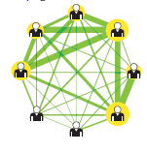
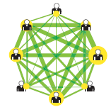
High Quality Process = Effective Flow of Energy in Group
“Team Within a Team”
Team of Equals

Slide 20

Act
common agenda and mutually reinforcing activities

Slide 21
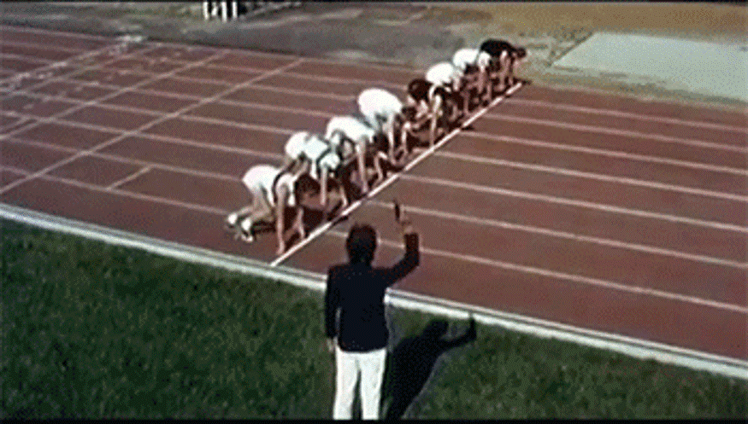
Ready for Action, But. . .

Slide 22
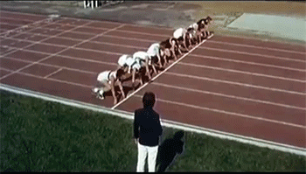
Ready for Action, But. . .

Slide 23
Common Agenda
FROM TO
writing a plan building a common commitment
involving experts involving everyone who cares
planning mentality inspiring and following our curiosity
a quick plan taking the time for broader engagement
How to Develop a Common Agenda for Collective Impact - Paul Born, Tamarack Institute
Notes:
Fundamental mindset shifts essential to creating a coalition’s shared vision
The field is learning and evolving into best practices that creating/refining a shared vision is
Substantially different from strategic planning thinking and methods
It’s about taking the time and creating the space needed to generate widespread commitment rather than a time constrained process that is all about a product
It’s about valuing and elevating context expertise (those who live the experience) rather than content expertise (those studied in the issue) – both/and
It’s about arousing the curiosity and energy that comes from thinking, sharing, learning together rather than centering around assumptions and givens
It’s about an engagement process rather than about a product – strive to be open, inclusive

Slide 24
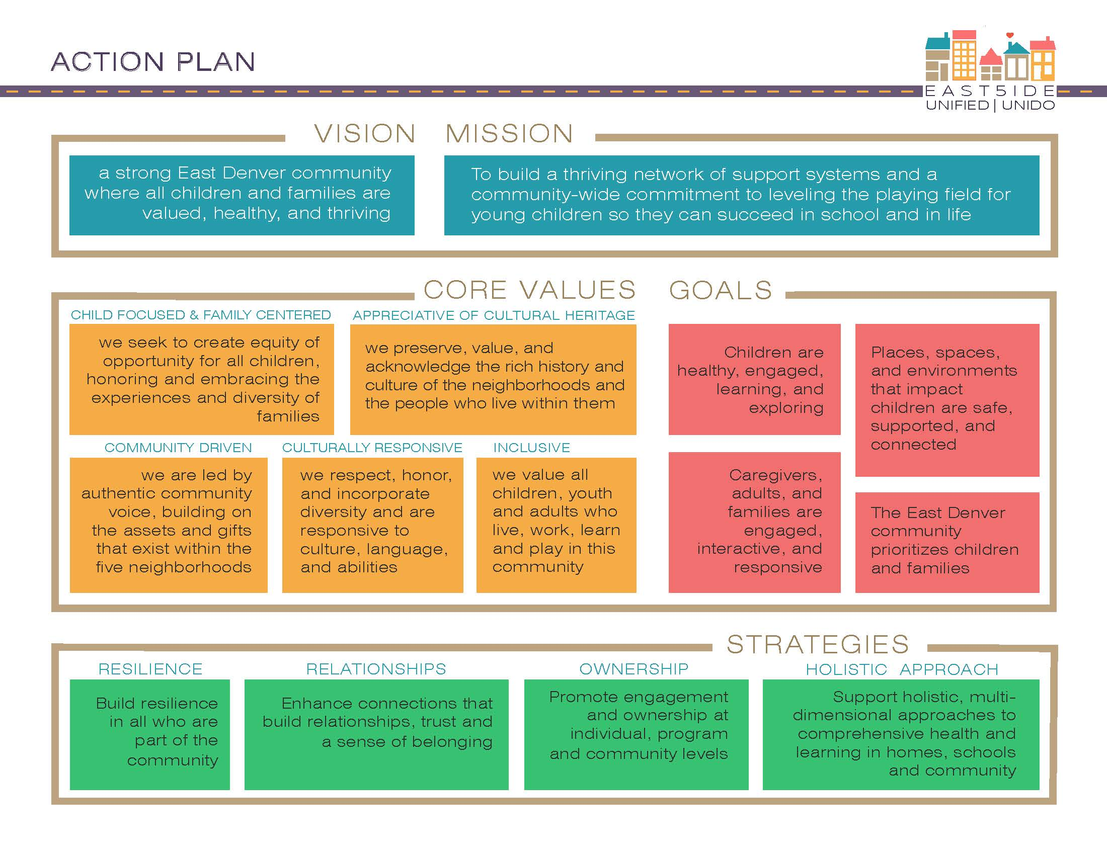

Slide 25

Learn
the big deal about data-driven decision making

Slide 26
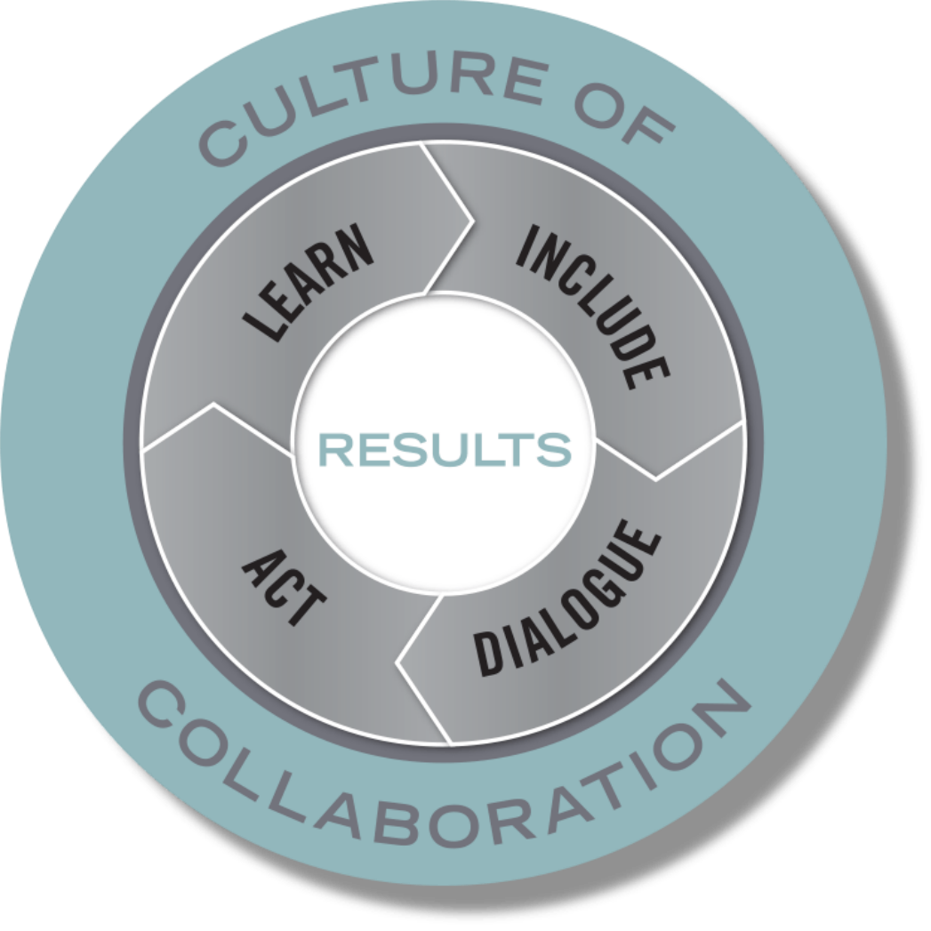
Data-Driven Decision Making Made Simple
Establish clear results—begin with the end in mind
Define how you will measure results—from X to Y by When
Include key partners in defining strategies that will work
Get the story behind the data—what would work to improve the situation?
Try something
Learn from what you tried—what worked? What didn’t? What can you try next time?
Repeat.
Make it part of your culture.

Slide 27
Brazosport Independent School District: Closing the Achievement Gap
From The Results Fieldbook by Mike Schmoker, 2001, ASCD Publications

Slide 28
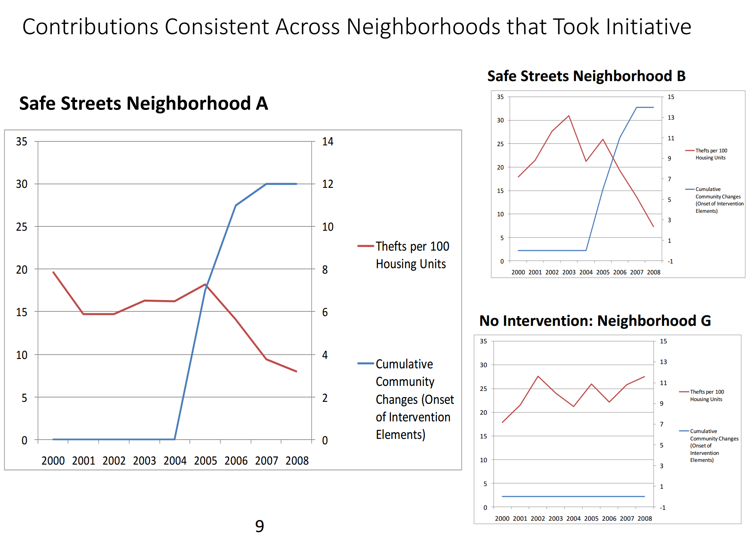

Slide 29
What to Tell your Board Chair When She Asks “What Will You Actually Do?”
Our 12-18 Month Deliverables:
  Build community will to address the issues (Include and Dialogue)
  Define our shared vision, goals and indicators (Results, Shared Measurement)
  Draft a community plan or action map (Act, Common Agenda and Shared Measurement)
  Take action for early wins and learn from results (Act, Learn)
  Formalize and mobilize the network (Act, Mutually Reinforcing Activities, Continuous Communication)
  Agree on a governance model (Culture of Collaboration, Backbone Support)
  Raise the funds to continue the work (Culture of Collaboration)

Slide 30
Structures for Success

Slide 31
Important Mindset Shifts in Collective Impact
From
To
Buy in
Programs
Positional Authority
Ownership
Systems
Shared and Adaptive Leadership

Slide 32
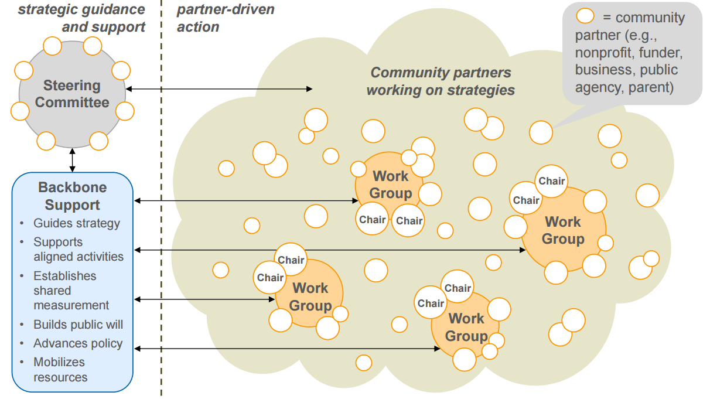
Governance Structure

Slide 33
VISION MAP
Compelling Vision: Become the healthiest
regions in the state
DRAFT
Vital Sign Indicators
Life expectancy
Suicide rates
Opioid related deaths
Depression/anxiety rates
Chronic disease burden
Cost reduction measures
Access to care measures
SDOH measures
Equity measures
Experience of care measures (member, care team)
Self-reported health and well-being assessments
Healthcare self-efficacy measures (patient engagement)
Adverse childhood experiences (ACEs) rates
Early childhood “school readiness” measures
Human Centered Design Approach
Deep, inclusive community participation
Ensuring patient experience informs our approaches
Complex care plans for members who touch multiple systems
Social determinants of health are key focus from the start
Data Driven Innovation and Investment
Focusing on highest need areas for improvement
Align incentives to high leverage areas of improvement
“Fail fast and learn” approach to innovation
Use of screening to identify and connect to resources
Integration of Services
Integration of physical and behavioral healthcare systems
Integration of oral health
Clinical and non-clinical supports—leveraging community partners to help address SDOH
Policy and Advocacy for Systems Change
Leveraging Medicaid
Identifying systemic changes needed to improve outcomes and informing HCPF
Guiding Approaches/Framework
Intentional Collaborative/Collective Impact Approach
Continuous improvement
Agile
Health and community partners
Collaborative governance
Promote shared buy-in and collaborative culture

Slide 34
STRATEGIES
PERFORMANCE MEASURES
MEASURES OF SUCCESS (INDICATORS)
COMPELLING VISION (RESULTS)
Intentional Collaborative/Collective Impact Approach
Wellness Visits
Dental Visits
Prenatal Engagement
7-Day Follow Up MH
SUD Engagement
Foster Care Assessment
BH Engagement
Health Neighborhood
Follow Up for Depression Screening
Follow Up for ED SUD Visits
ED Visits
Potentially Avoidable Costs
Life expectancy by zip code
Suicide rates
Depression/anxiety rates
Opioid related deaths
Chronic disease burden
Access to care measures
Equity measures
Self-reported health and well-being assessments
Adverse childhood experiences (ACEs) rates
Early childhood “school readiness” measures
Cost reduction measures
Become the healthiest regions in the state.
Achieve health equity in our regions.
Maintain the lowest healthcare costs in the state.
Human Centered Design Approach
Data Sharing
Integration of Physical and Behavioral Health

Slide 35
Role of PIAC
Core roles PIAC is outlined to play
What this looks like within a Collective Impact framework
Review the Contractor’s (Colorado Access) deliverables
Discuss program policy changes and provide feedback
Review the Contractor’s (Colorado Access) and Program’s performance data
Provide representatives for the statewide PIAC
Review Member materials and provide feedback – COA’s Member Advisory Council will fulfill this role

Slide 36
Specific Areas of Collective work
Regional Vision Map
Region 3 Comprehensive Community Needs Assessment
Region 3 Comprehensive Community Engagement Plan
RAE Incentive Sharing Model

Slide 37
Next Steps

